Slide 1










Slide 2
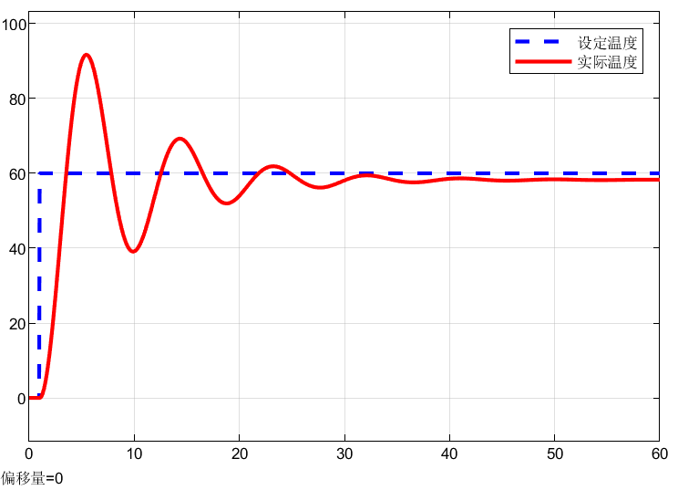




幅度/dB
40
20
1
10
100
1000
角频率/rad/s
-20

Slide 3



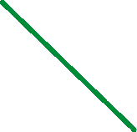



幅度/dB
角频率 rad/s

Slide 4





幅度/dB
40
20
1
10
100
1000
角频率/rad/s
-20

Slide 5
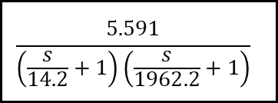



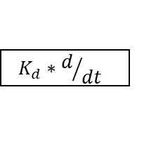


$$K_{P}$$
SP
err
+
CO
$$\frac{5.591}{\left(\frac{s}{14.2}+1\right)\left(\frac{s}{1962.2}+1\right)}$$
y
+
$$K_{I}∗\int{dt}$$
-
+
FB
$$K_{d}∗d/{dt}$$
ω=1
$$ω_{c}$$
ω=1
$$ω_{c}$$

Slide 6
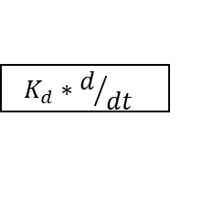



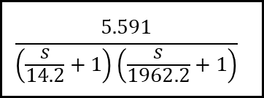
$$K_{P}$$
SP
err
+
CO
$$\frac{5.591}{\left(\frac{s}{14.2}+1\right)\left(\frac{s}{1962.2}+1\right)}$$
y
+
$$K_{I}∗\int{dt}$$
-
+
FB
$$K_{d}∗d/{dt}$$

Slide 7
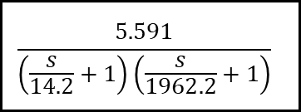


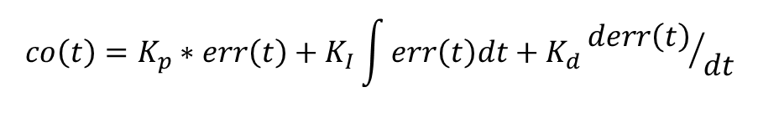

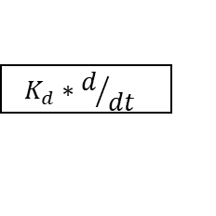
$$K_{P}$$
SP
err
+
CO
$$\frac{5.591}{\left(\frac{s}{14.2}+1\right)\left(\frac{s}{1962.2}+1\right)}$$
y
+
$$K_{I}∗\int{dt}$$
-
+
FB
$$K_{d}∗d/{dt}$$
$$co\left(t\right)=K_{p}∗err\left(t\right)+K_{I}\int{err\left(t\right)dt}+K_{d}{derr\left(t\right)}/{dt}$$

Slide 8
$$K_{P}$$
SP
err
+
CO
$$\frac{5.591}{\left(\frac{s}{14.2}+1\right)\left(\frac{s}{1962.2}+1\right)}$$
y
+
$$K_{I}∗\int{dt}$$
-
+
FB
$$K_{d}∗d/{dt}$$

Slide 9




Slide 10

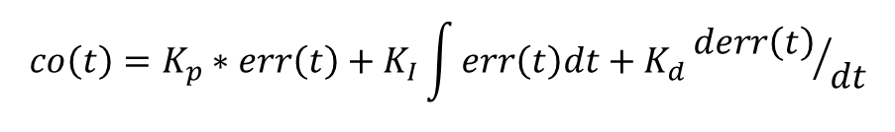

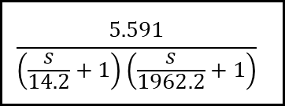
$$K_{P}$$
SP
err
+
CO
$$\frac{5.591}{\left(\frac{s}{14.2}+1\right)\left(\frac{s}{1962.2}+1\right)}$$
y
+
$$K_{I}∗\int{dt}$$
-
+
FB
$$K_{d}∗d/{dt}$$
$$co\left(t\right)=K_{p}∗err\left(t\right)+K_{I}\int{err\left(t\right)dt}+K_{d}{derr\left(t\right)}/{dt}$$

Slide 11
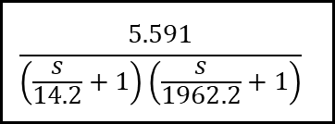



$$K_{P}$$
SP
err
+
CO
$$\frac{5.591}{\left(\frac{s}{14.2}+1\right)\left(\frac{s}{1962.2}+1\right)}$$
y
+
$$K_{I}∗\frac{1}{s}$$
-
+
FB
$$K_{D}∗s$$

Slide 12
$$K_{P}$$
SP
err
+
CO
$$\frac{5.591}{\left(\frac{s}{14.2}+1\right)\left(\frac{s}{1962.2}+1\right)}$$
y
+
$$K_{I}∗\int{dt}$$
-
+
FB
$$K_{d}∗d/{dt}$$

Slide 13
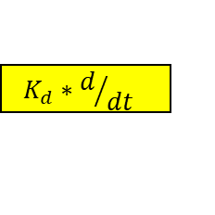


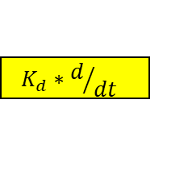


$$K_{P}$$
err
+
CO
+
$$K_{I}∗\int{dt}$$
+
$$K_{d}∗d/{dt}$$
$$K_{P}$$
err
+
CO
+
$$K_{I}∗\int{dt}$$
err
CO
$$K_{p}$$
err
CO
+
$$K_{P}$$
+
$$K_{d}∗d/{dt}$$

Slide 14
例1：有如下三个系统，试确定PID的类型并对其补偿

Slide 15
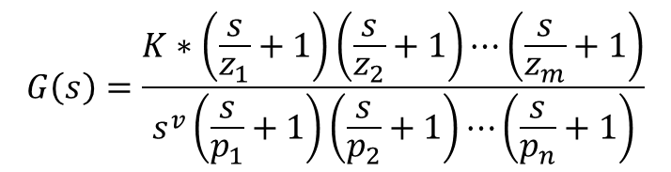
例2：计算下面的波特图所对应的Kp，Ki和Kd的参数
$$G\left(s\right)=\frac{K∗\left(\frac{s}{z_{1}}+1\right)\left(\frac{s}{z_{2}}+1\right)⋯\left(\frac{s}{z_{m}}+1\right)}{s^{v}\left(\frac{s}{p_{1}}+1\right)\left(\frac{s}{p_{2}}+1\right)⋯\left(\frac{s}{p_{n}}+1\right)}$$

Slide 16
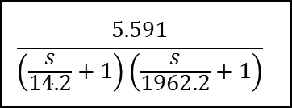



$$u_{a}\left(t\right)$$
$$\frac{5.591}{\left(\frac{s}{14.2}+1\right)\left(\frac{s}{1962.2}+1\right)}$$
$$ω\left(t\right)$$
幅度/dB
40
20
$20log\left(5.591\right)≈15d$B
1962.2
1
10
14.2
100
1000
角频率/rad/s
-20

Slide 17
$$u_{a}\left(t\right)$$
$$\frac{5.591}{\left(\frac{s}{14.2}+1\right)\left(\frac{s}{1962.2}+1\right)}$$
$$ω\left(t\right)$$
幅度/dB
40
20
$20log\left(5.591\right)≈15d$B
1962.2
1
10
14.2
100
1000
角频率/rad/s
-20

Slide 18

幅度/dB
40
20
1
10
14.2
100
1000
角频率/rad/s
-20
考虑到非线性问题，
适当减小K

